Slide 1
Sessions 5
Tokens, NFT, Tokenomics
Blockchain Protocols and Decentralized Applications

Slide 2
Objectives
Cryptocurrency
Fungible Tokens
Non Fungible Tokens
Tokenomics

Slide 3
Cryptocurrencies
Total market cap: 3.46T $
Bitcoin - 1.89T $
Over 15.000 tokens* tracked
20% of U.S. adults have invested in or traded cryptocurrencies
NFTs - 11B $
What do you think gives value to cryptocurrencies and tokens?
* fungible

Slide 4
Fungible Tokens
Interchangeable assets (1 ETH = 1 ETH)
Native or non-native
Native: ETH, EGLD, SOL
Used to pay gas for blockchain usaged
Non-native:
ERC-20: USDT, WETH
ESDT: MEX, WEGLD
Use cases
Stablecoins - simulate fiat money
Governance
Utility tokens
Demo ERC-20 vs ESDT

Slide 5
Non Fungible Tokens
Unique assets
Implementation
Ethereum: ERC-721/ERC-1155
MultiversX: ESDTs
Use cases
Digital art
Gaming assets
Certificates
Real estate
Demo (NFT Marketplace)
Brainstorming

Slide 6
Tokenomics
Token + economics
Supply
Fixed supply: Bitcoin 21M cap, MultiversX 31.42M EGLD;
Infinite supply: DOGE, Ethereum;
Inflationary
Dogecoin (DOGE) - 5B tokens minted annually;
Ethereum - EIP-1559 introduced burn mechanism - deflationary during high network activity;
MultiversX - case study on next slide
Deflationary
Bitcoin?
Binance Coin (BNB)
Shiba Inu (SHIB)

Slide 7
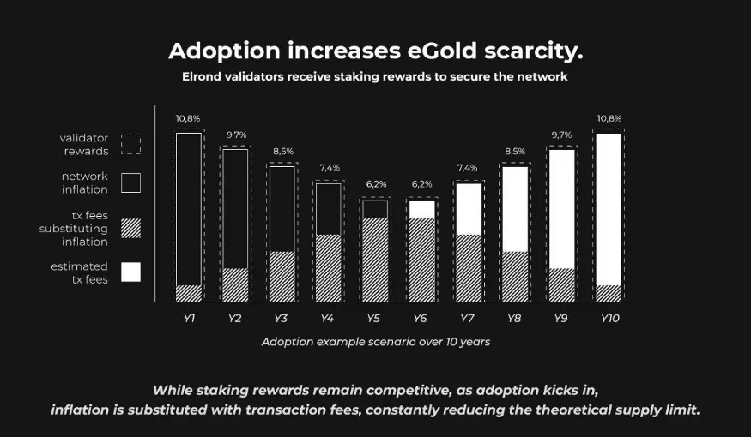
Case Study - MultiversX

Slide 8
Tokenomics
Utility
Access, rewards, governance
Incentives
Staking Providers
Distribution
ICO - initial coin offering
Airdrops
Governance
Decentralized decision making based on token ownership

Slide 9
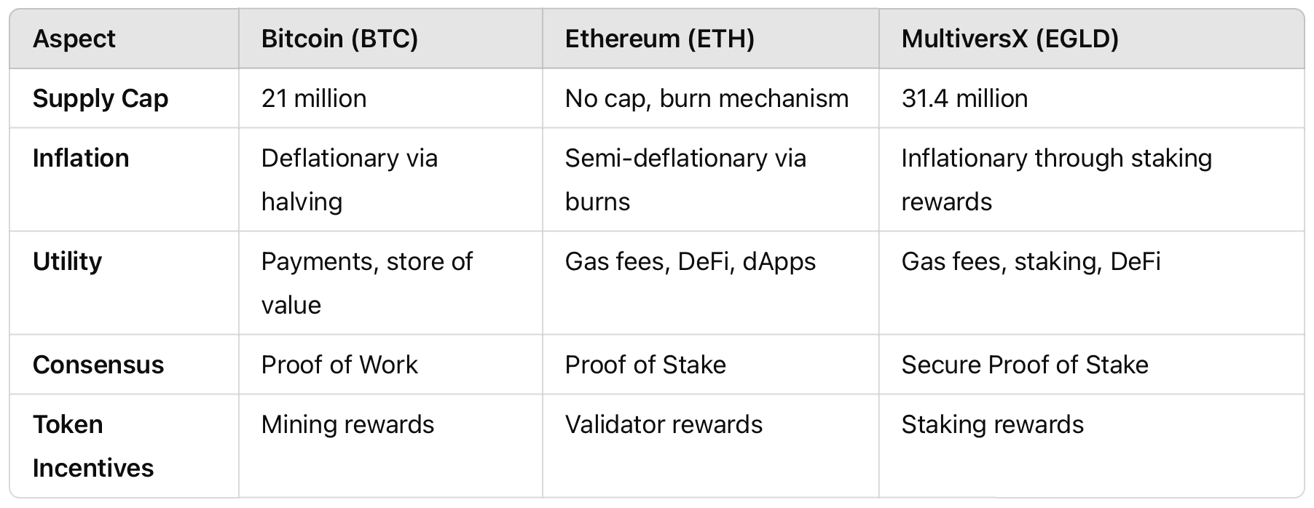
Comparison BTC-ETH-MvX

Slide 10
Bitcoin (BTC)
Supply Dynamics:
Fixed supply cap of 21 million BTC. No more BTC will ever be created once this cap is reached.
Block reward halving occurs approximately every 4 years, reducing new BTC issuance by 50%.
Estimated final BTC will be mined in the year 2140.
Utility:
Primarily a store of value ("digital gold").
Used for peer-to-peer payments.
Incentives:
Mining rewards decrease over time, encouraging long-term price appreciation due to scarcity.
Security is incentivized through transaction fees as block rewards diminish.
Distribution:
Early adopters and miners accumulated significant BTC; however, mining has become centralized due to the need for specialized hardware.
Challenges:
Lack of programmability limits its use cases beyond payments and store of value.
Environmental concerns due to Proof of Work mining.

Slide 11
Ethereum (ETH)
Supply Dynamics:
Initially had an uncapped supply, but with the introduction of EIP-1559, Ethereum implemented a burn mechanism that removes a portion of transaction fees from circulation.
The move to Proof of Stake (PoS) has significantly reduced new ETH issuance (approximately 0.43% inflation rate annually under current conditions).
Network activity directly influences whether ETH behaves inflationary or deflationary.
Utility:
Native token for gas fees on the Ethereum blockchain.
Powers smart contracts, decentralized applications (dApps), and DeFi ecosystems.
Incentives:
Validators earn rewards for securing the network in PoS.
Burn mechanism aligns user activity with token scarcity, potentially increasing value.
Distribution:
Initial distribution through an ICO in 2014.
Ongoing rewards to validators in PoS.
Challenges:
High transaction fees during network congestion.
Intense competition from newer Layer 1 blockchains offering scalability.

Slide 12
MultiversX (EGLD)
Supply Dynamics:
Fixed maximum supply of 31.4 million EGLD.
Supply decreases over time; in 10 years, no inflation.
Utility:
Used to pay for transaction fees on the MultiversX blockchain.
Staking rewards for network validators and delegators.
Acts as the base currency for ecosystem dApps, DeFi protocols, and NFT marketplaces.
Incentives:
Staking and delegation reward mechanisms ensure decentralization.
Distribution:
Started with a token swap (from ERD to EGLD) and an initial supply allocation to early investors, staking rewards, and ecosystem incentives.
Challenges:
Competes in a saturated market against Ethereum and other Layer 1 blockchains.
Ecosystem growth is key to sustaining value.

Slide 13
Token Value
1 UTK = 0.048$
How can we provide a price to a token?
Demo
Create a token
Give it a value in $

